Slide 1
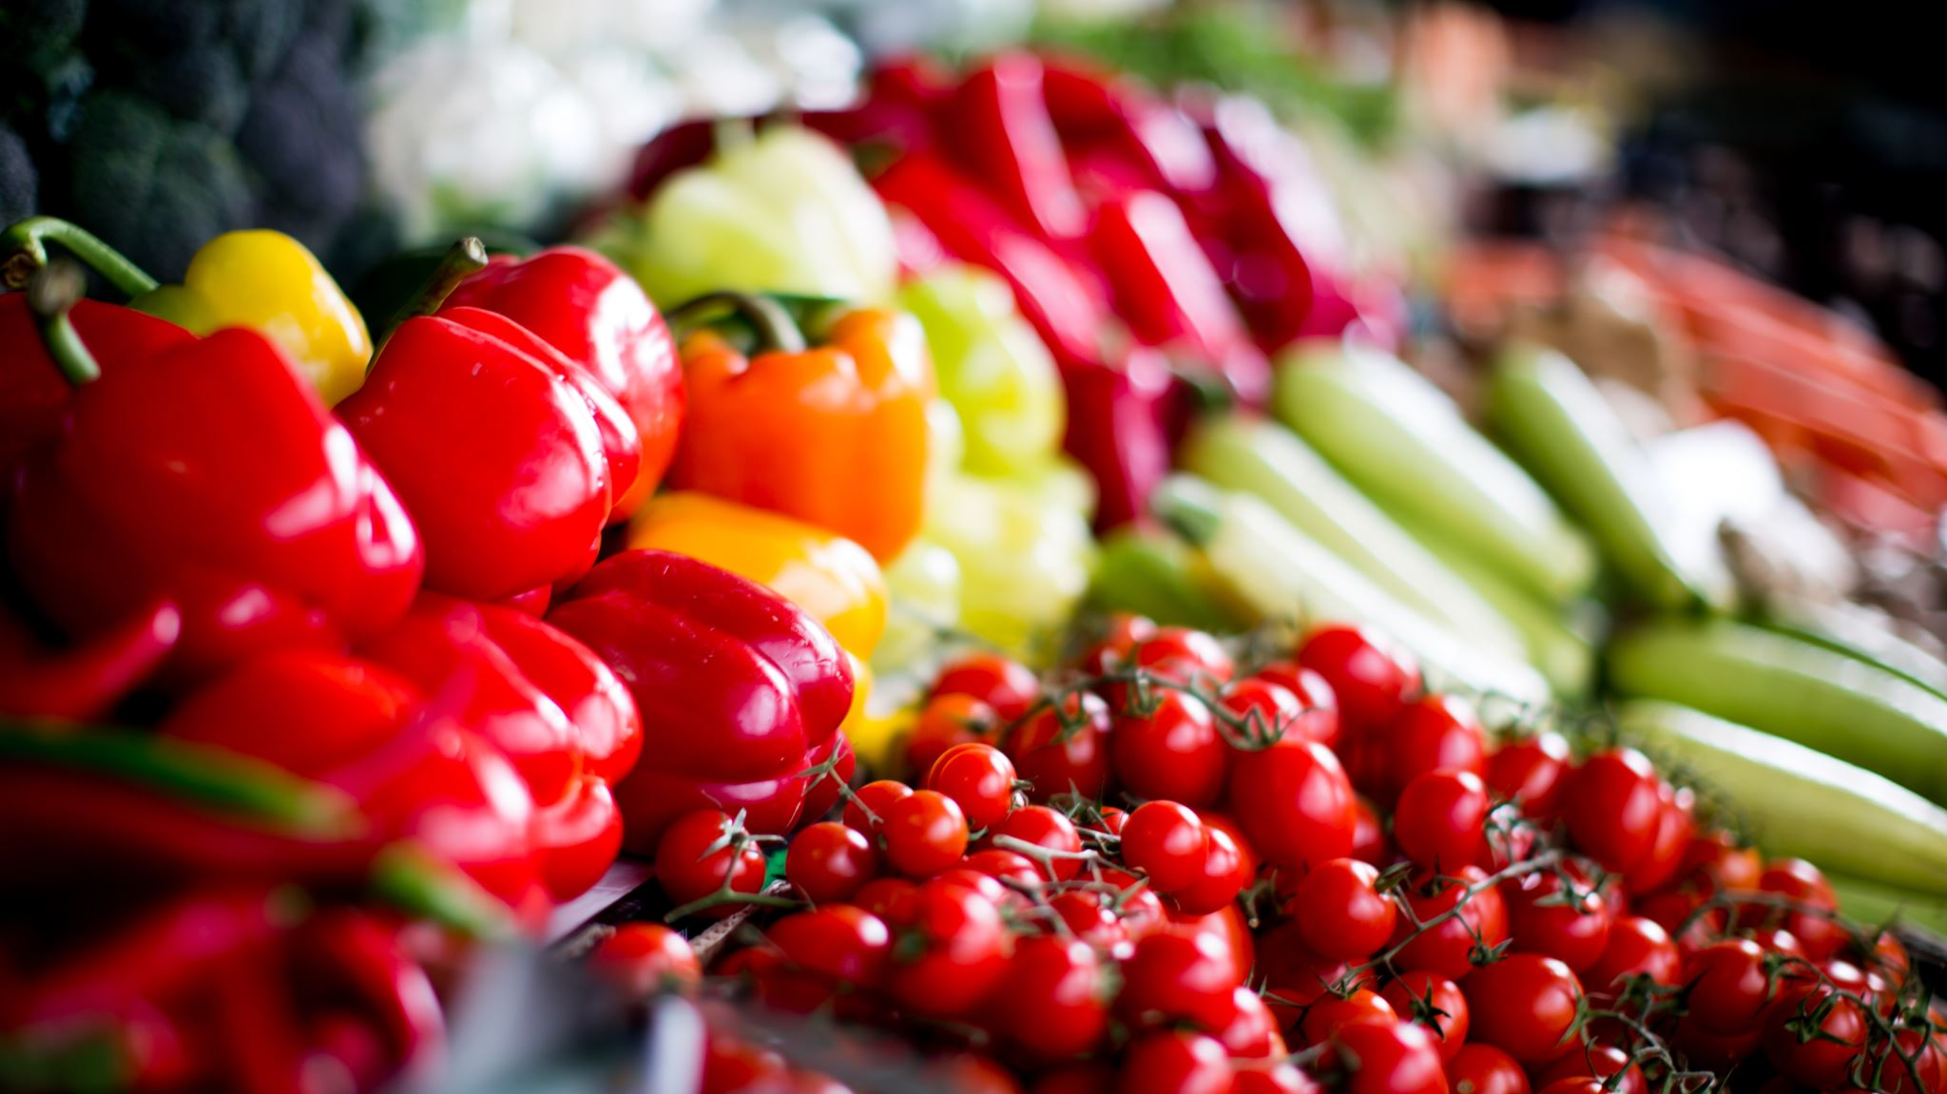
Food Loss & Waste Individual Part
Christoph Meier
Data Visualization and Narration W.MSCIDS_DVN03.H2101
MSc in Applied Information and Data Science
HSLU, 16.12.21

Slide 2
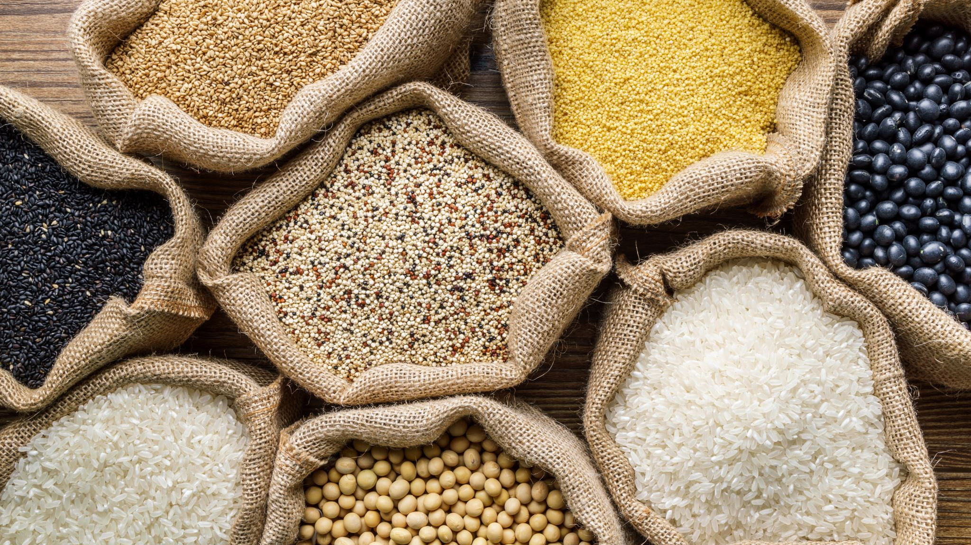
Project Overview
Topic Global Food Loss & Waste
Goal Create a visualization which promotes an emotional reaction and sparks action by my target group on the topic food loss & waste
Target Group Young, well educated adults with a stable financial situation no kids and an interest in sustainability topics
Notes:
My goal: Structured into 3 parts
Who do I want to reach: -> quick recap of my target group
What message do I want to tell:
How do I want to tell this message: Clear / transparent / Consistent / Tailored for the audience / Not to simple

Slide 3
User-Scenario
It’s almost Christmas, the time for giving!
Our client, a NGO dedicated to reduce food loss & waste, wants to attract donations or create awareness on the topic.
The story must be clear, transparent, detailed, provide insightful information and, if possible, interactive.
Notes:
Explanatory or Exploratory -> try different drafts
Static or interactive –> try two different drafts
Exploratory & Static -> Graphical interface / Slide with a lot of info
Explanatory & Static -> Hand drawn, one goal and story
Explanatory & Interacitve -> Dashboard with goal and story but also dynamic

Slide 4

How to reach the Target Group?
Set the context
Use insightful visuals
Direct the attention towards the action points
Wrap inside a story
Possible Media Types:
Leaflet
Magazine article
Dashboard
Notes:
Explanatory or Exploratory -> try different drafts
Static or interactive –> try two different drafts
Exploratory & Static -> Graphical interface / Slide with a lot of info
Explanatory & Static -> Hand drawn, one goal and story
Explanatory & Interacitve -> Dashboard with goal and story but also dynamic
Create a story
The increased total amount of food loss along a timeline
For interactive data vis, split it along the time, select specific foods
Show change in the supply chain

Slide 5

The Design Process
Understand
Understand the data and create a data set
Decide
Decide the Form and Function
Exploratory or Explanatory
Static or Interactive
Find suitable visualizations
Look for inspiration
Sketch
Context
Appropriate visuals
Direct attention
Create a story
Notes:
Explanatory or Exploratory -> try different drafts
Static or interactive –> try two different drafts
Exploratory & Static -> Graphical interface / Slide with a lot of info
Explanatory & Static -> Hand drawn, one goal and story
Explanatory & Interacitve -> Dashboard with goal and story but also dynamic

Slide 6
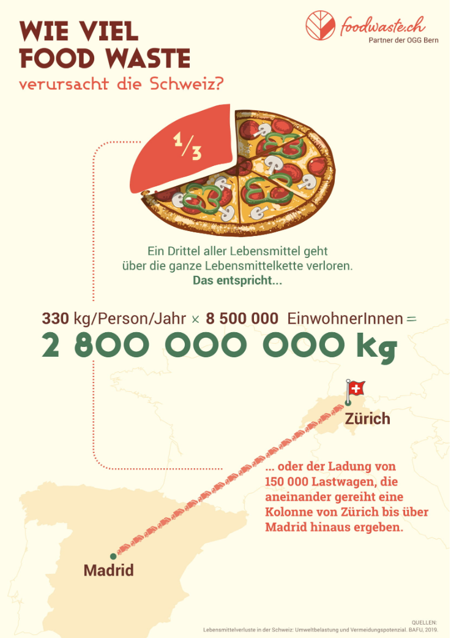
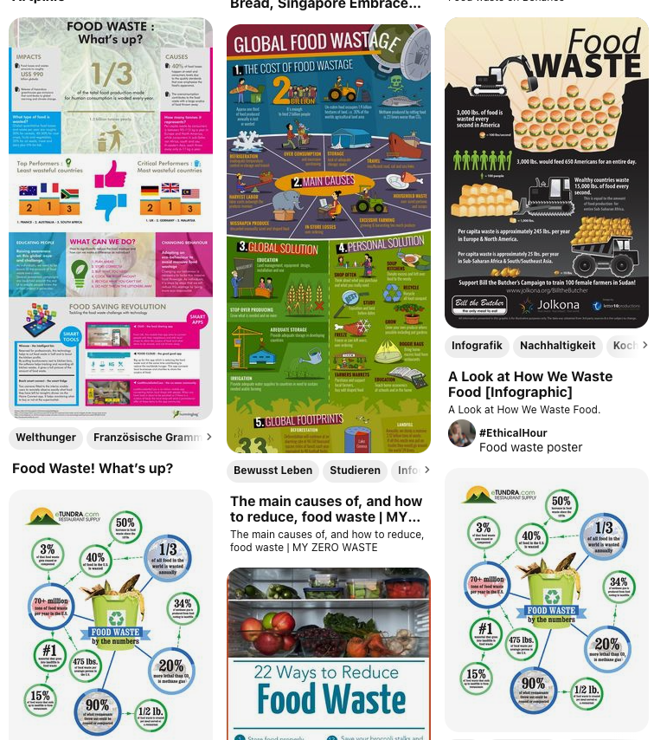
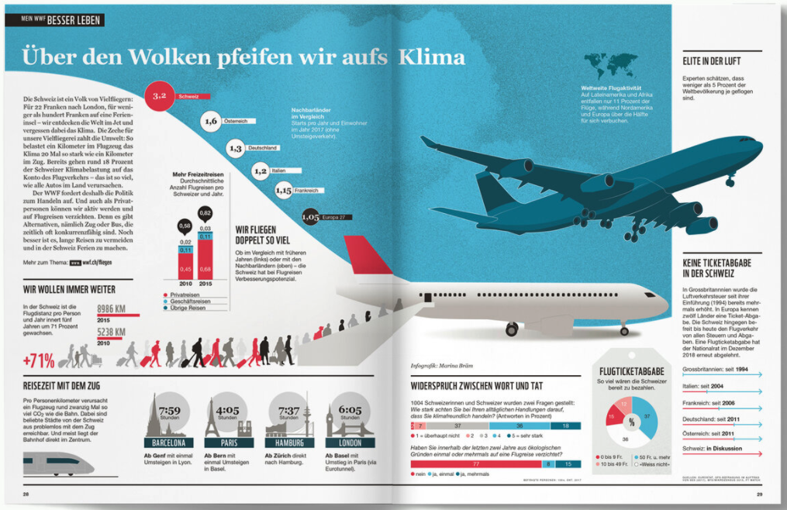
Sources of Inspiration
Course slides
https://www.viz-bybraem.com/works
https://www.pinterest.com/Smartphoodapp/food-waste-poster/
https://foodwaste.ch/was-ist-food-waste/
https://truth-and-beauty.net/projects

Slide 7
There is a Pattern and we need to break it!
The four countires which have the highest percentage of food loss in their whole supply chain are all african countries or regions.
And it either is caused in farming or processing, problems better knowledge can help to solve!

Slide 8
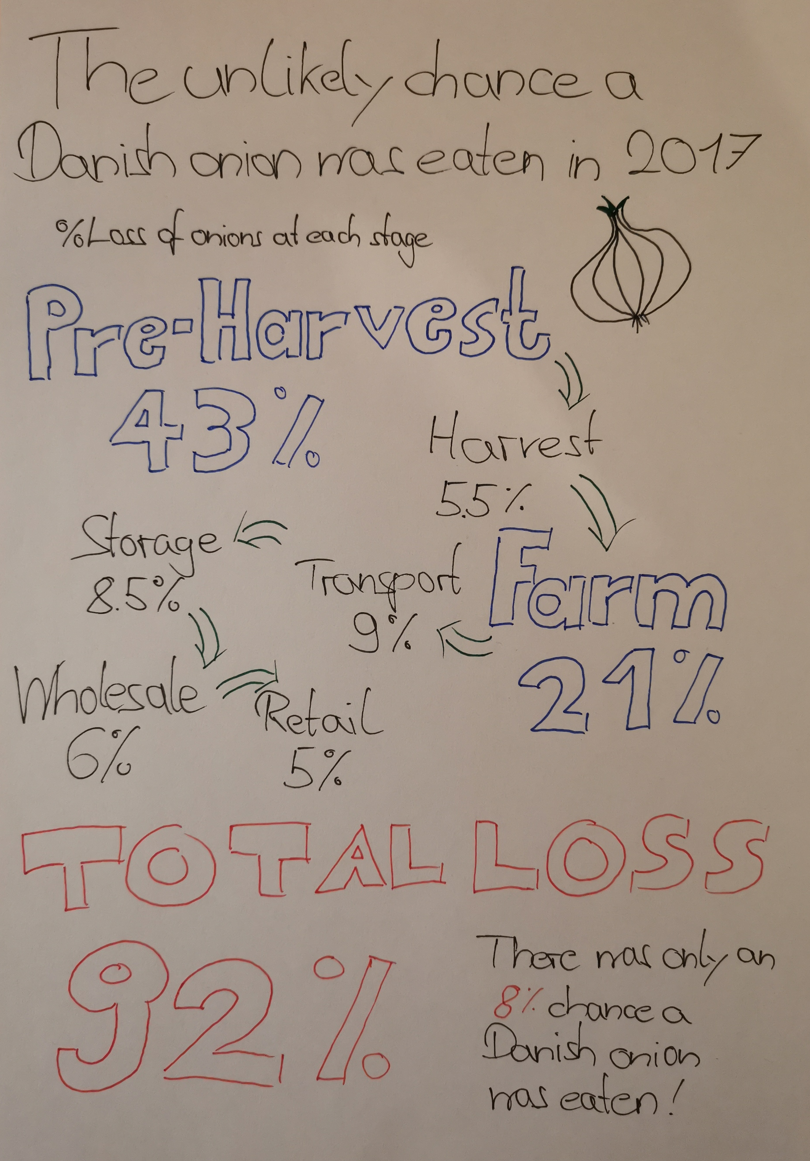
Visualization 2
Notes:
Explanatory or Exploratory -> try different drafts
Static or interactive –> try two different drafts
Exploratory & Static -> Graphical interface / Slide with a lot of info
Explanatory & Static -> Hand drawn, one goal and story
Explanatory & Interacitve -> Dashboard with goal and story but also dynamic

Slide 9
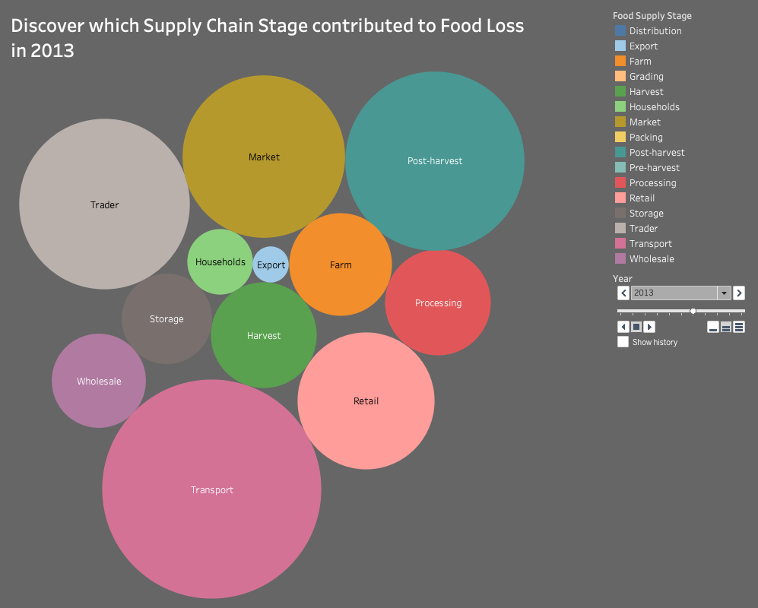
Visualization 3
Notes:
Explanatory or Exploratory -> try different drafts
Static or interactive –> try two different drafts
Exploratory & Static -> Graphical interface / Slide with a lot of info
Explanatory & Static -> Hand drawn, one goal and story
Explanatory & Interacitve -> Dashboard with goal and story but also dynamic

Slide 10
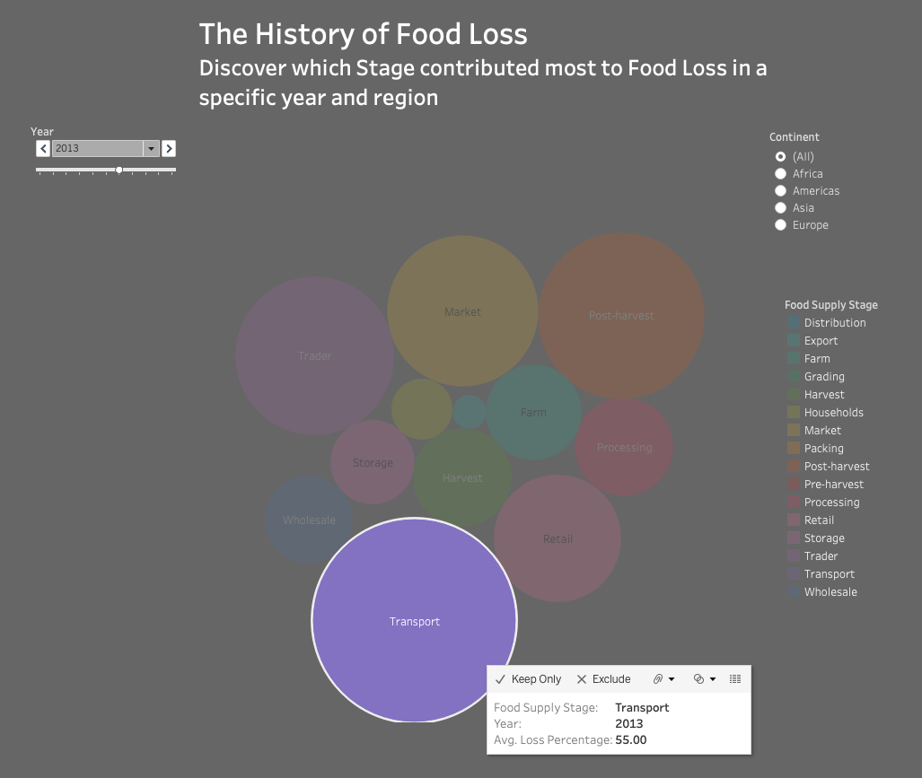
Final
Take action!
We can inform you about projects to improve each step in the supply chain
Notes:
Explanatory or Exploratory -> try different drafts
Static or interactive –> try two different drafts
Exploratory & Static -> Graphical interface / Slide with a lot of info
Explanatory & Static -> Hand drawn, one goal and story
Explanatory & Interacitve -> Dashboard with goal and story but also dynamic

Slide 11
Argumentation
The initial visualizations were classified into the matrix of form and function
What our target group values:
Insight
Story
Discovering
Detailed
Decision: Interacting with the data and discovering own stories is key, hence a interactive Dashboard fits best
Result: Visualization 3
Static
Visualization 1 The Pattern
Visualization 2 The Onion
Exploratory
Explanatory
Visualization 3 The Bubbles
Interactive
Notes:
Explanatory or Exploratory -> try different drafts
Static or interactive –> try two different drafts
Exploratory & Static -> Graphical interface / Slide with a lot of info
Explanatory & Static -> Hand drawn, one goal and story
Explanatory & Interacitve -> Dashboard with goal and story but also dynamic

Slide 12
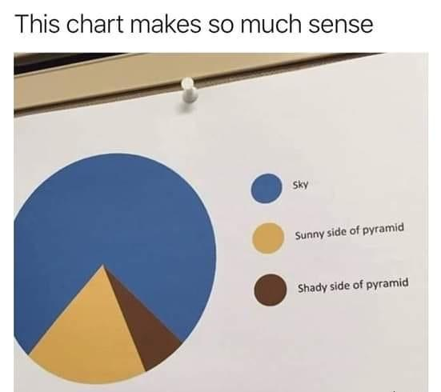
Conclusion
Understanding the data and target group is key
Do not think, the first version will be perfect
Keep following points in mind:
Form and Function
Visual perception concepts
Types of visualisations
Story
Layering
Creating visualisations take a lot of time
Notes:
Form and Fucntion
– Static / Interactive
– Exploratory / Explanatory
Visual perception
Direct attention with color, highlighting, shapes, spacing
Layering
– Try to create layers to reduce complexity and shift focus

Slide 13
References and Appendix
Data source: https://www.fao.org/platform-food-loss-waste/flw-data/en/
Data Set & Data Clean: https://drive.switch.ch/index.php/s/8Snu04zfSXERai8
Tools used: Tableau 2021.3 Microsoft PowerPoint Microsoft Excel Jupyter Notebooks
Notes:
Explanatory or Exploratory -> try different drafts
Static or interactive –> try two different drafts
Exploratory & Static -> Graphical interface / Slide with a lot of info
Explanatory & Static -> Hand drawn, one goal and story
Explanatory & Interacitve -> Dashboard with goal and story but also dynamic

